Slide 1
Transcomputation
Dr James Anderson FBCS CITP CSci
安德生

Slide 2
Agenda
Total hardware
Total software

Slide 3
Puzzle
How would you arrange a total ALU?
How would you arrange total memory addressing?
How would you arrange total I/O?
Physical errors are, ultimately, unavoidable so what are the consequences of an error in a total system?
How would you arrange a total CPU?

Slide 4
Definitions
Totallity - a total function gives a result in its output class when applied to any arguments in its input class
Waiting time - the time an algorithm takes to complete

Slide 5
Pipeline machines
Totallity + known waiting time = ideal pipeline concurrency
Pipelines deliver energy efficiency and unlimited scalability with constant computational efficiency

Slide 6
Concurrency

Slide 7
Concurrency
Parallelism minimises latency
Pipelining maximises concurrency

Slide 8
Von Neumann program
Instruction 1
Data 1
Instruction 2
Instruction 3
Instruction n

Slide 9
Von Neumann program
Instruction 1
Instruction 2
Data 1
Instruction 3
Instruction n

Slide 10
Von Neumann program
Instruction 1
Instruction 2
Instruction 3
Data 1
Instruction n

Slide 11
Von Neumann program
Instruction 1
Instruction 2
Instruction 3
Instruction n
Data 1

Slide 12
Pipeline program
Instruction 1
Data 1
Instruction 2
Instruction 3
Instruction n

Slide 13
Pipeline program
Instruction 1
Data 2
Instruction 2
Data 1
Instruction 3
Instruction n

Slide 14
Pipeline program
Instruction 1
Data 3
Instruction 2
Data 2
Instruction 3
Data 1
Instruction n

Slide 15
Pipeline program
Instruction 1
Data n
Instruction 2
Data 3
Instruction 3
Data 2
Instruction n
Data 1

Slide 16
Pipeline program
Instruction 1
Instruction 2
Data n
Instruction 3
Data 3
Instruction n
Data 2

Slide 17
Pipeline program
Instruction 1
Instruction 2
Instruction 3
Data n
Instruction n
Data 3

Slide 18
Pipeline program
Instruction 1
Instruction 2
Instruction 3
Instruction n
Data n

Slide 19
Hardware

Slide 20
Pipeline machine
Throughput is independent of program length
Data concurrency increases with program length
The bigger the program, the faster it is - relative to a von-Neumann-core machine

Slide 21
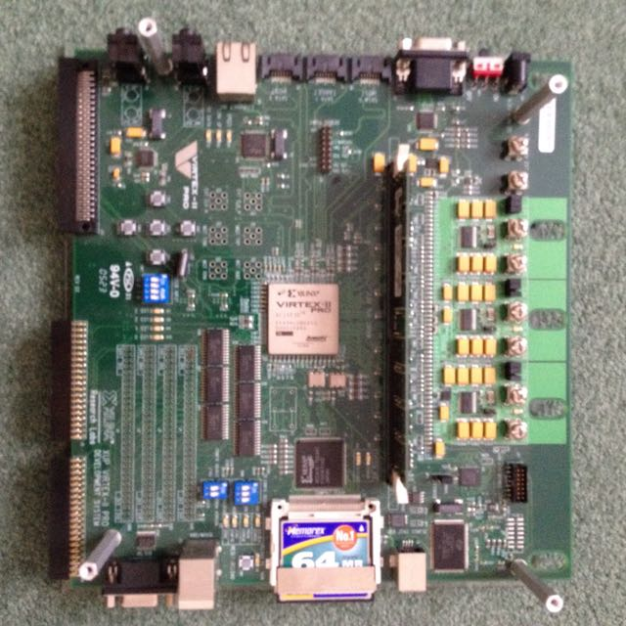
FPGA prototype

Slide 22
Architectural prototype
Token = 16 bit header + 80 bit float datum
64 k mills per chip
2 M mills per board
16 M mills per cabinet
20 kW per unweighted PWFLOP

Slide 23
Relative addressing
Fixed size, relative address implements an address horizon in an arbitrarily large machine and maintains constant computational efficiency regardless of the size of the machine
Small horizon keeps the token header small

Slide 24
Conditional indirection
Token header has one bit to signify delivery of the datum and one bit to signify redirection of the datum, with redirection address held in mill
Thus two bits in the token header implement arbitrarily complex routing
Keeps the token header small

Slide 25
Conditional execution
Token header has one bit to signify execution of the instruction held in mill
Keeps token header small

Slide 26
Architectural prototype
Square array of mills
Pipelined communication not just nearest neighbour
Mill
Mill
Mill

Slide 27
Pipelined communication
Multiple mills emulate a von Neumann address space but with cycle time proportional to distance travelled
Multiple mills emulate a systolic array but with bottleneck on chip I/O
Multiple mills implement a 2D pipeline with 1D I/O giving bottleneck on chip I/O

Slide 28
2D pipeline
Unbreakable if-then-elseif-…-elseif-else-endif pipeline
If
Then
…
Elseif
Then
…
Elseif
Then
…

Slide 29
Known waiting time
If the waiting time of an algorithm is known then its program can be laid out in an unbreakable 2D pipeline or slipstream
Slipstream programs have a cadence of the slower of the times to effect the input or output of a record

Slide 30
Known waiting time
Slipstream programs, with shared data, can execute concurrently
Throughput = Cadence / Programs
So an entire program can accumulate a result in less than one clock tick!

Slide 31
Molecular dynamics
Many clock ticks to input one record to specify a molecule
One clock tick to input one record to specify a molecule interaction
Many clock ticks to output one record to update a molecule

Slide 32
Molecular dynamics
2 M mill board inputs 500 molecule specification records in many clock ticks
Accumulates 500 molecule-molecule interactions per clock tick, over a stream of very many interaction records
Outputs 500 molecule update records in many clock ticks
Asymptotes to 500 program runs per clock tick

Slide 33
Unknown waiting time
If code can be unrolled to one outer loop then data can be circulated through external memory and the body of the loop retains a known waiting time with all of the above advantages
If loops cannot be unrolled then cadence is the longer of the I/O or loop-body times

Slide 34
Exception handling
If machine is total then no logical system exceptions possible so no exception handling needed
If waiting time is known then no programmer exception handling needed, just let a computational path halt and report after the waiting time
Report physical faults on a schedule and roll back to preceding checkpoint
Programmer reports unknown-waiting-time exceptions

Slide 35
Software

Slide 36
Programming
Architecture is Turing complete so any programming language can be used
Map-Reduce programs, with data streams of known length, are guaranteed to be slipstreamable
Von Neumann programs with counted loops, no recursion and no pointers are guaranteed to be slipstreamable

Slide 37
Demonstration
(click on next slide)

Slide 39
Summary

Slide 40
Relative addressing
Reduces token size, making hardware more reliable and reducing power consumption
Makes the machine scalable to any size, with constant efficiency

Slide 41
Conditional indirection
Implements arbitrarily complex routing in just two header bits

Slide 42
2D addressing of mills
Reduces token size, making hardware more reliable and reducing power consumption
Branches laid out in space so no dynamic, branch-prediction failures
Reduces time order of computations:

Slide 43
Pipelined communication
Emulates von Neumann addressing
Emulates systolic addressing
Delivers ideal data concurrency
Can have long latency

Slide 44
Totality
Reduces the number of program (model) errors
Delivers unbreakable pipelines
Removes all logical system errors
Every syntactically correct program is semantically correct

Slide 45
General programming
Von Neumann languages because Turing complete
Systolic programming

Slide 46
Slipstream programming
Von Neumann languages restricted to: counted loops, no pointers, no recursion
Map-Reduce with known-length data-streams

Slide 47
Conclusion
Power efficient because all tokens move a short distance per clock tick
Scalable to any size with constant efficiency
Safer code because totality removes many exceptions
Enormous throughput of repeated computations
Might deliver exascale on 20 MW power budget

